Slide 1
Graphs

Slide 2
Graphs
A data structure that consists of a set of nodes (vertices) and a set of edges that relate the nodes to each other
Formally, a graph is a pair: G = (V, E)
A set of vertices, also known as nodes:
V = {v₁,v₂,…,v_{n}}
A set of edges E = {e₁,e₂,…,e_{m}}
Each edge e_{i} is a pair of vertices (v_{j},v_{k})
An edge "connects" the vertices

Slide 3
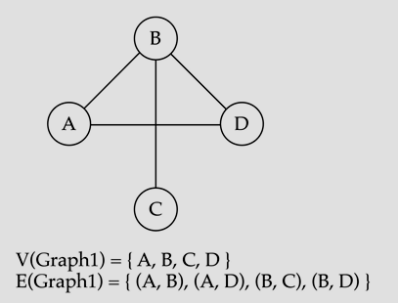
Graphs

Slide 4
Graph Terminologies
Adjacent nodes / neighbours: two nodes are adjacent if they are connected by an edge.
A is adjacent to B and D
Path: a sequence of vertices that connect two nodes in a graph.
A-D-B-C or C – B – D – A – B
Complete graph: a graph in which every vertex is directly connected to every other vertex.
Subgraph ABD
Degree: The degree of vertex i is the no. of edges incident on vertex
Degree(A) = 2
Degree (C) = 1

Slide 5
Undirected Graphs
In undirected graphs, edges have no specific direction
Edges are always "two-way"
Thus, (u, v) ∊ E implies (v, u) ∊ E.
Only one of these edges needs to be in the set
The other is implicit, so normalize how you check for it
Degree of a vertex: number of edges containing that vertex
Put another way: the number of adjacent vertices

Slide 6
Directed Graphs
In directed graphs (or digraphs), edges have direction
Thus, (u, v) ∊ E does not imply (v, u) ∊ E.
Let (u, v) ∈ E mean u → v
Call u the source and v the destination
In-Degree of a vertex: number of in-bound edges (edges where the vertex is the destination)
Out-Degree of a vertex: number of out-bound edges (edges where the vertex is the source)
D
D
A
A
C
or
C
B
B
2 edges here

Slide 7
Weighted Graphs
In a weighted graph, each edge has a weight or cost
Typically numeric (ints, decimals, doubles, etc.)
Some graphs allow negative weights; many do not
Clinton
20
Mukilteo
Kingston
30
Edmonds
Bainbridge
35
Seattle
60
Bremerton

Slide 8
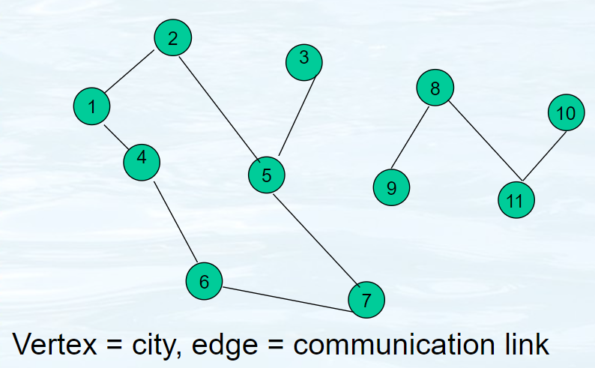
Application-Communication link

Slide 9
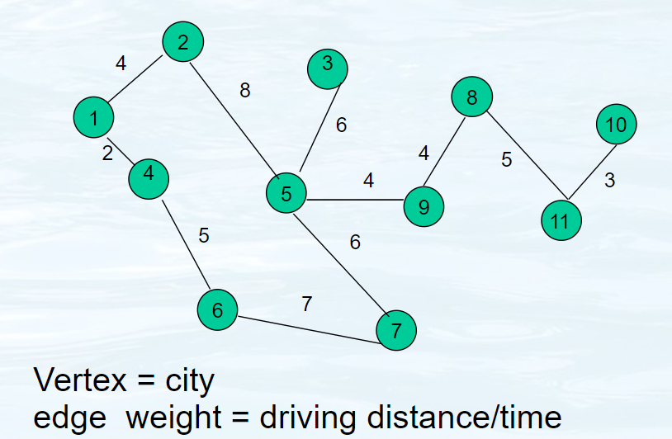
Application – Distance / Time Map

Slide 10
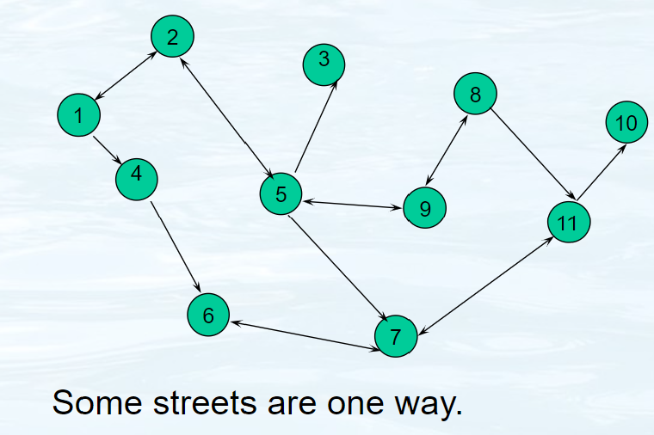
Application – Street Map

Slide 11
Paths and Cycles
We say "a path exists from v₀ to v_{n}" if there is a list of vertices [v₀, v₁, …, v_{n}] such that (v_{i},v_{i+1}) ∊ E for all 0 ≤ i<n.
A cycle is a path that begins and ends at the same node (v₀==v_{n})
Chicago
Seattle
Salt Lake City
San Francisco
Dallas
Example path (that also happens to be a cycle):
[Seattle, Salt Lake City, Chicago, Dallas, San Francisco, Seattle]

Slide 12
Path Length and Cost
Path length: Number of edges in a path
Path cost: Sum of the weights of each edge
Example where
P= [ Seattle, Salt Lake City, Chicago, Dallas, San Francisco, Seattle]
3.5
Chicago
Seattle
length(P) = 5
cost(P) = 11.5
2
2
2
Salt Lake City
2.5
2.5
2.5
Length is sometimes called "unweighted cost"
3
San Francisco
Dallas

Slide 13
Simple Paths and Cycles
A simple path repeats no vertices (except the first might be the last):
[Seattle, Salt Lake City, San Francisco, Dallas]
[Seattle, Salt Lake City, San Francisco, Dallas, Seattle]
A cycle is a path that ends where it begins:
[Seattle, Salt Lake City, Seattle, Dallas, Seattle]
A simple cycle is a cycle and a simple path:
[Seattle, Salt Lake City, San Francisco, Dallas, Seattle]

Slide 14
Paths and Cycles in Directed Graphs
D
Example:
Is there a path from A to D?
Does the graph contain any cycles?
C
A
B

Slide 15
Undirected Graph Connectivity
An undirected graph is connected if for all
pairs of vertices u≠v, there exists a path from u to v
An undirected graph is complete, or fully connected, if for all pairs of vertices u≠v there exists an edge from u to v
Connected graph
Disconnected graph

Slide 16
Directed Graph Connectivity
A directed graph is strongly connected if there is a path from every vertex to every other vertex
A directed graph is weakly connected if there is a path from every vertex to every other vertex ignoring direction of edges
A direct graph is complete or fully connected, if for all pairs of vertices u≠v , there exists an edge from u to v

Slide 17
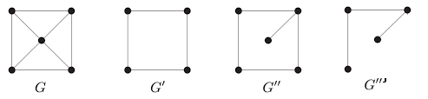
Subgraphs
A graph whose vertices and edges are subsets of another graph.
Formal Definition: A graph G'=(V', E') is a subgraph of another graph G=(V, E)
iff. V'⊆ V, and E'⊆ E
A spanning subgraph is a subgraph that contains all the vertices of the original graph.

Slide 18
Trees as Graphs
We can say a tree is a graph that is:
undirected
acyclic
connected
All trees are graphs, but NOT all graphs are trees
D
E
B
A
C
F
G
H

Slide 19
Directed Acyclic Graphs (DAGs)
A DAG is a directed graph with no directed cycles
Every rooted directed tree is a DAG
But not every DAG is a rooted directed tree
Every DAG is a directed graph
But not every directed graph is a DAG

Slide 20
More Notation
D
A
C
For a graph G = (V, E):
|V| is the number of vertices
|E| is the number of edges
Minimum? 0
Maximum for undirected? |V||V-1|/2 ∈ O(|V|²)
Maximum for directed? |V||V-1| ∈ O(|V|²)
So for any graph, |E| is O(|V|²)
Another fact: If an undirected graph is connected,
then |E| ≥ |V|-1
B

Slide 21
Density / Sparsity
|E| is often much smaller than its maximum size
We do not always approximate as |E| as O(|V|²)
This is a correct bound, but often not tight
If |E| is Θ(|V|²) (the bound is tight), we say the graph is dense
More sloppily, dense means "lots of edges"
If |E| is O(|V|) we say the graph is sparse
More sloppily, sparse means "most possible edges missing"

Slide 22
What’s the Data Structure?
Graphs are often useful for lots of data and questions
Example: "What’s the lowest-cost path from x to y"
But we need a data structure that represents graphs
Which data structure is "best" can depend on:
properties of the graph (e.g., dense versus sparse)
the common queries about the graph ("is (u ,v) an edge?" vs "what are the neighbors of node u?")
We will discuss two standard graph representations
Adjacency Matrix and Adjacency List
Different trade-offs, particularly time versus space

Slide 23
Adjacency Matrix
Assign each node a number from 0 to |V|-1
A |V| x |V| matrix of Booleans (or 0 vs. 1)
Then M[u][v] == true means there is an edge from u to v
 | A | B | C | D
A | F | T | F | F
B | T | F | F | F
C | F | T | F | T
D | F | F | F | F
D
A
C
B

Slide 24
Adjacency Matrix Properties
Running time to:
Get a vertex’s out-edges:
Get a vertex’s in-edges:
Decide if some edge exists:
Insert an edge:
Delete an edge:
Space requirements:
Best for sparse or dense graphs?
 | A | B | C | D
A | F | T | F | F
B | T | F | F | F
C | F | T | F | T
D | F | F | F | F

Slide 25
Adjacency Matrix Properties
Running time to:
Get a vertex’s out-edges: O(|V|)
Get a vertex’s in-edges: O(|V|)
Decide if some edge exists: O(1)
Insert an edge: O(1)
Delete an edge: O(1)
Space requirements:
O(|V|²)
Best for sparse or dense graphs? dense
 | A | B | C | D
A | F | T | F | F
B | T | F | F | F
C | F | T | F | T
D | F | F | F | F

Slide 26
Adjacency Matrix Properties
How can we adapt the representation for weighted graphs?
Instead of Boolean, store a number in each cell
Need some value to represent ‘not an edge’
0, -1, or some other value based on how you are using the graph
Might need to be a separate field if no restrictions on weights

Slide 27
Adjacency List
Assign each node a number from 0 to |V|-1
An array of length |V| in which each entry stores a list of all adjacent vertices (e.g., linked list)
D
A
B
/
A
C
B
A
/
B
C
D
B
/
D
/

Slide 28
Examples
1
2
1
3
2
3
4
1 → 3
2 → 2
3 → 1 → 2
1 → 2 → 3
2 → 1
3 → 1
4 →

Slide 29
Adjacency List Properties
A
B
/
Running time to:
Get a vertex’s out-edges:
Get a vertex’s in-edges:
Decide if some edge exists:
Insert an edge:
Delete an edge:
Space requirements:
Best for sparse or dense graphs?
B
A
/
C
D
B
/
D
/

Slide 30
Adjacency List Properties
Running time to:
Get a vertex’s out-edges: O(d) where d is out-degree of vertex
Get a vertex’s in-edges: O(|E|)
Decide if some edge exists: O(d) where d is out-degree of source
Insert an edge: O(1) (unless you need to check if it’s already there)
Delete an edge: O(d) where d is out-degree of source
Space requirements: O(|V|+|E|)
Best for sparse or dense graphs? sparse

Slide 31
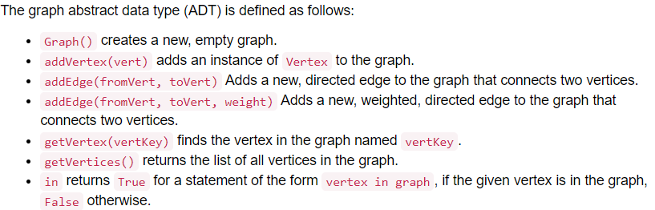
Graph ADT

Slide 32
ADT
class Graph: def __init__(self): self.vertList = {} self.numVertices = 0
def addVertex(self,key):
def getVertex(self,n): def addEdge(self,f,t,cost=0
def getVertices(self):
def createAdjMatrix(self):
def dfs(self):
def bfs(self):
Class vertex
defaddNeighbor(self,nbr,weight=0):
def getConnections(self):
def getID(self):
def getweight(self):

Slide 33
Graph Traversals (Search)
We have covered some of these with binary trees
Breadth-first search (BFS)
Depth-first search (DFS)
A traversal (search):
An algorithm for systematically exploring a graph
Visiting (all) vertices
Until finding a goal vertex or until no more vertices
Only for connected graphs

Slide 34
Breadth-first search
One of the simplest algorithms
Also one of the most important
It forms the basis for MANY graph algorithms

Slide 35
BFS: Level-by-level traversal
One of the simplest algorithms
Also one of the most important
It forms the basis for MANY graph algorithms
Given a starting vertex s
Visit all vertices at increasing distance from s
Visit all vertices at distance k from s
Then visit all vertices at distance k+1 from s
Then ….

Slide 36
Queue: A B E C G D F
A
B
E
G
C
D
F

Slide 37
Generalizing BFS
Cycles:
We need to save auxiliary information
Each node needs to be marked
Visited: No need to be put on queue
Not visited: Put on queue when found
What about assuming only two children vertices?
Need to put all adjacent vertices in queue

Slide 38
BFS(graph g, vertex s)
unmark all vertices in G
q ← new queue
mark s
enqueue(q, s)
while (not empty(q))
curr ← dequeue(q)
visit curr // e.g., print its data
for each edge <curr, V>
if V is unmarked
mark V
enqueue(q, V)

Slide 39
The general BFS algorithm
Each vertex can be in one of three states:
Unmarked and not on queue
Marked and on queue
Marked and off queue
The algorithm moves vertices between these states

Slide 40
Handling vertices
Unmarked and not on queue:
Not reached yet
Marked and on queue:
Known, but adjacent vertices not visited yet (possibly)
Marked and off queue:
Known, all adjacent vertices on queue or done with

Slide 41
Queue: A
A
B
E
G
C
D
F
Start with A. Mark it.

Slide 42
Queue: A B E
A
B
E
G
C
D
F
Expand A’s adjacent vertices.
Mark them and put them in queue.

Slide 43
Queue: A B E C G
A
B
E
G
C
D
F
Now take B off queue, and queue its neighbors.

Slide 44
Queue: A B E C G D F
A
B
E
G
C
D
F
Do same with E.

Slide 45
Queue: A B E C G D F
A
B
E
G
C
D
F
Visit C.
Its neighbor F is already marked, so not queued.

Slide 46
Queue: A B E C G D F
A
B
E
G
C
D
F
Visit G.

Slide 47
Queue: A B E C G D F
A
B
E
G
C
D
F
Visit D. F, E marked so not queued.

Slide 48
Queue: A B E C G D F
A
B
E
G
C
D
F
Visit F.
E, D, C marked, so not queued again.

Slide 49
Queue: A B E C G D F
A
B
E
G
C
D
F
Done. We have explored the graph in order:
A B E C G D F.

Slide 50
Interesting features of BFS
Complexity: O(|V| + |E|)
All vertices put on queue exactly once
For each vertex on queue, we expand its edges
In other words, we traverse all edges once
BFS finds shortest path from s to each vertex
Shortest in terms of number of edges
Why does this work?

Slide 51
Spanning tree
Spanning tree:
Given an undirected and connected graph G=(V,E), a spanning tree of the graph G is a tree that spans G (that is, it includes every vertex of G) and is a subgraph of G (every edge in the tree belongs to G).
Multiple Spanning trees
Minimum spanning tree:
Minimum spanning tree is the spanning tree where the cost is minimum among all the spanning trees.
Can have multiple MSTs

Slide 52
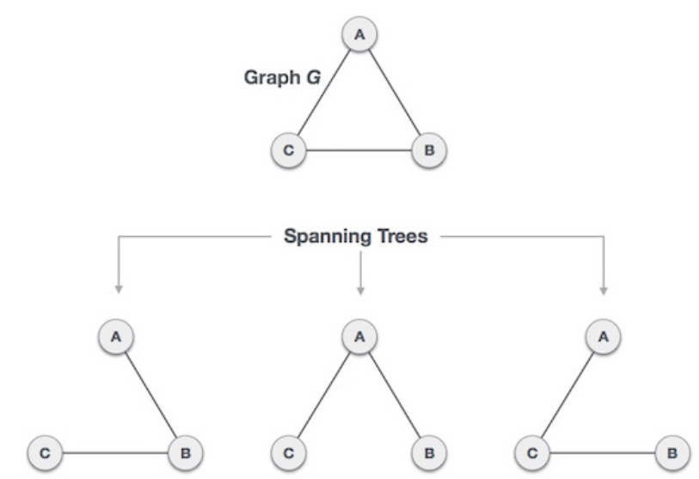
Spanning tree

Slide 53
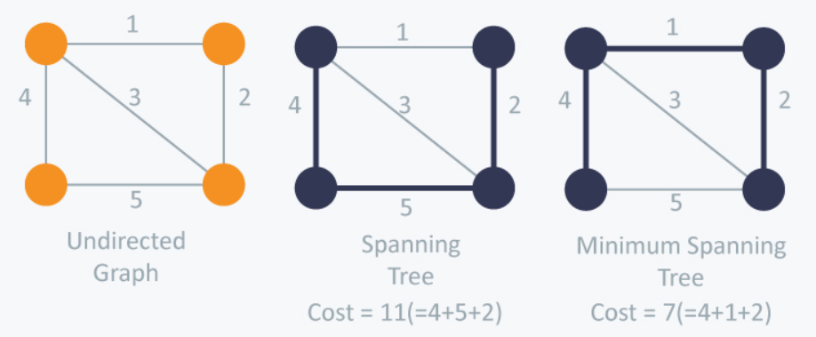
Spanning tree

Slide 54
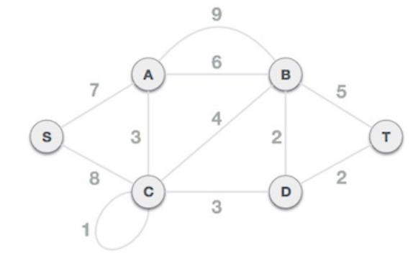
Prims Algo for MST
Approach:
- Greedy approach
- Treats the nodes as a single tree and keeps on adding new nodes to the spanning tree from the given graph

Slide 55
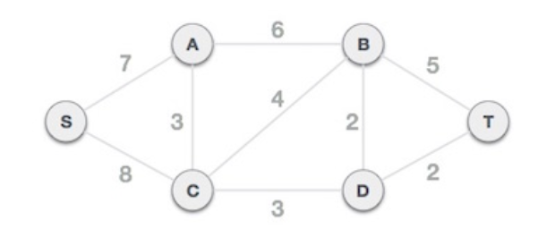
Prims Algo for MST
Approach:
- Greedy approach
- Treats the nodes as a single tree and keeps on adding new nodes to the spanning tree from the given graph
Step-1 Remove parallel edges and loops

Slide 56
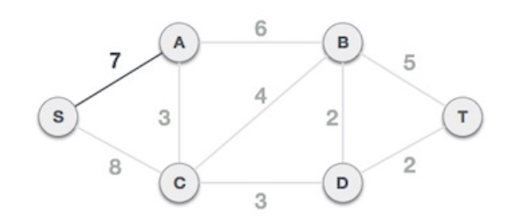
Prims Algo for MST
Step 2 - Choose any arbitrary node as root node
Step 3 - Check outgoing edges and select the one with less cost

Slide 57
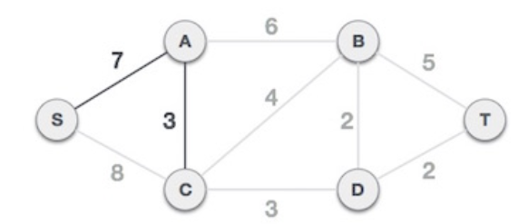
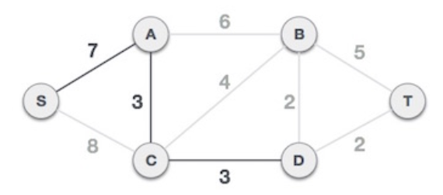
Prims Algo for MST
Now select the next minimum edge that can arise from the MST

Slide 58
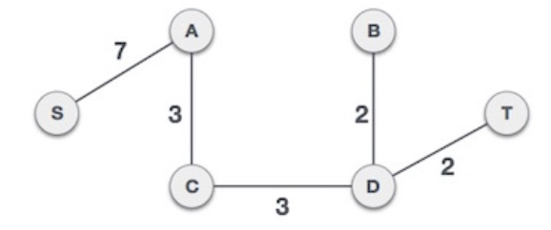
Prims Algo for MST
Now select the next minimum edge that can arise from the MST
What is the cost?

Slide 59
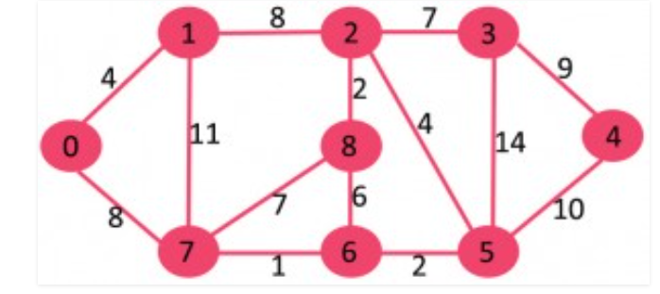
Kruskal algo for MST
Steps:
1. Sort all the edges in non-decreasing order of their weight. 2. Pick the smallest edge. Check if it forms a cycle with the spanning tree formed so far. If cycle is not formed, include this edge. Else, discard it. 3. Repeat step#2 until there are (V-1) edges in the spanning tree.

Slide 60
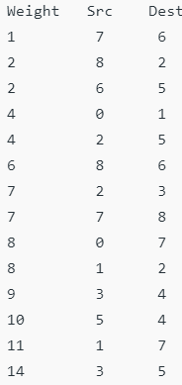
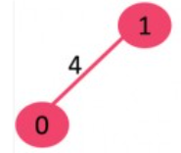
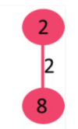
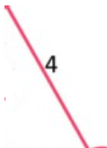


Kruskal algo for MST
Steps:
1. Sort all the edges in non-decreasing order of their weight. 2. Pick the smallest edge. Check if it forms a cycle with the spanning tree formed so far. If cycle is not formed, include this edge. Else, discard it. 3. Repeat step#2 until there are (V-1) edges in the spanning tree.

Slide 61
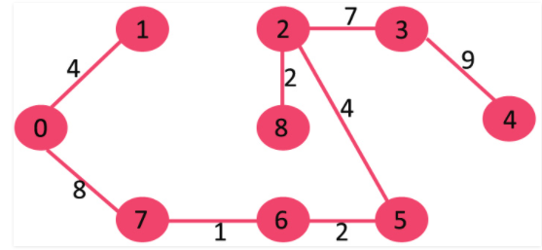
Kruskal algo for MST
Steps:
1. Sort all the edges in non-decreasing order of their weight. 2. Pick the smallest edge. Check if it forms a cycle with the spanning tree formed so far. If cycle is not formed, include this edge. Else, discard it. 3. Repeat step#2 until there are (V-1) edges in the spanning tree.

Slide 62
Biconnected Components
Let G = (V;E) be a connected, undirected graph.
An articulation point or separation vertex of G is a vertex whose removal disconnects G.
A bridge or a separation edge of G is an edge whose removal disconnects G.
A connected graph G is biconnected if, for any two vertices u and v of G, there are two disjoint paths between u and v, i.e,
two paths sharing no common edges or vertices, except u and v.

Slide 63
Biconnected Components
A biconnected component of G is a maximal set of edges such that any two edges in the set lie on a common simple cycle
Let G be a connected graph. The follówing are equivalent:
G is biconnectèd.
For any two vertices of G, there is a simple cycle containing them.
G does not have separation vertices or separation edges.
These concepts are important because they can be used to identify vulnerabilities of networks

Slide 64
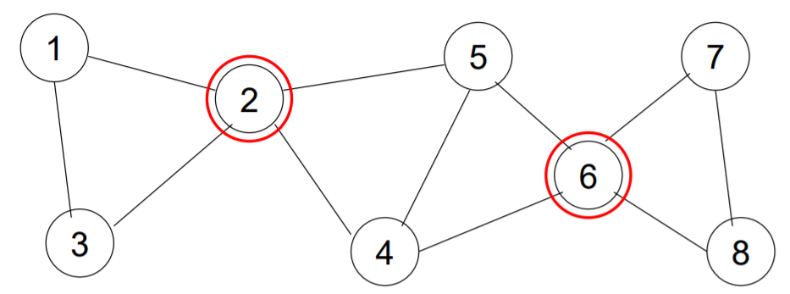
Articulation points

Slide 65
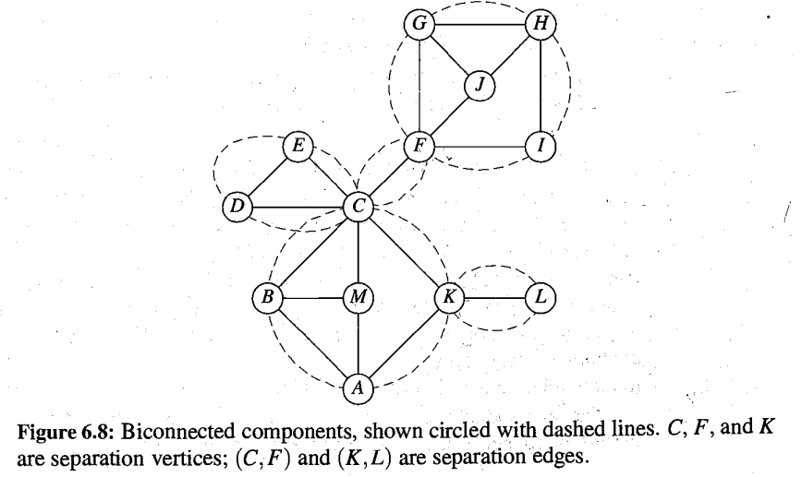
Articulation points and biconnected components

